Slide 1
10. Unsupervised Learning (III)
IT 348/448

Slide 2
Topics
Density-based clustering

Slide 3
Density-Based Clustering Methods
Clustering based on density (local cluster criterion), such as density-connected points
Major features:
Discover clusters of arbitrary shape
Handle noise
One scan
Need density parameters as termination condition
Several interesting studies:
DBSCAN: Ester, et al. (KDD’96)
OPTICS: Ankerst, et al (SIGMOD’99).
DENCLUE: Hinneburg & D. Keim (KDD’98)
CLIQUE: Agrawal, et al. (SIGMOD’98) (more grid-based)

Slide 4
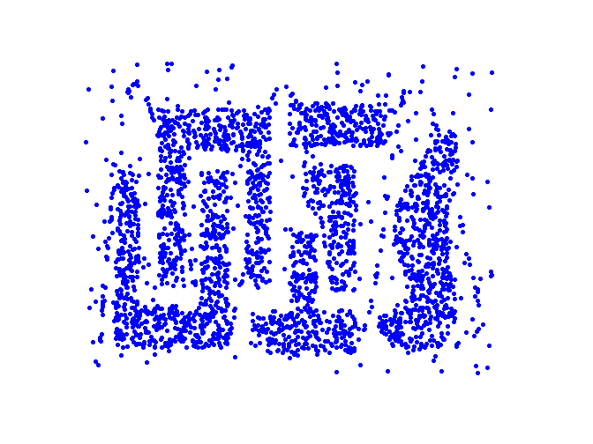
Density-Based Clustering
Clusters are regions of high density that are separated from one another by regions on low density

Slide 5
Density-Based Clustering: Basic Concepts
Two parameters:
Eps: Maximum radius of the neighborhood
MinPts: Minimum number of points in an Eps-neighborhood of that point
N_{Eps}(p): {q belongs to D | dist(p,q) ≤ Eps}
Directly density-reachable: A point p is directly density-reachable from a point q w.r.t. Eps and MinPts if
p belongs to N_{Eps}(q)
core point condition:
|N_{Eps} (q)| ≥ MinPts
p
MinPts = 5
Eps = 1 cm
q

Slide 6
Definitions of Terms
Density = number of points within a specified radius (Eps)
A point is a core point if it has at least a specified number of points (MinPts) within Eps
These are points that are at the interior of a cluster
Counts the core point itself
A border point is not a core point but is within the neighborhood of a core point.
A noise point is any point that is not a core point or a border point.

Slide 7
Examples

Slide 8
Density-Reachable and Density-Connected
Density-reachable:
A point p is density-reachable from a point q w.r.t. Eps and MinPts if there is a chain of points p₁, …, p_{n}, p₁ = q, p_{n} = p such that p_{i+1} is directly density-reachable from p_{i}
q: core object
p: an object
p
p₁
q

Slide 9
Density-Reachable and Density-Connected
Density-connected
A point p is density-connected to a point q w.r.t. Eps and MinPts if there is a point o such that both p and q are density-reachable from o w.r.t. Eps and MinPts
p: object
q: object
o: core object
p
q
o

Slide 10
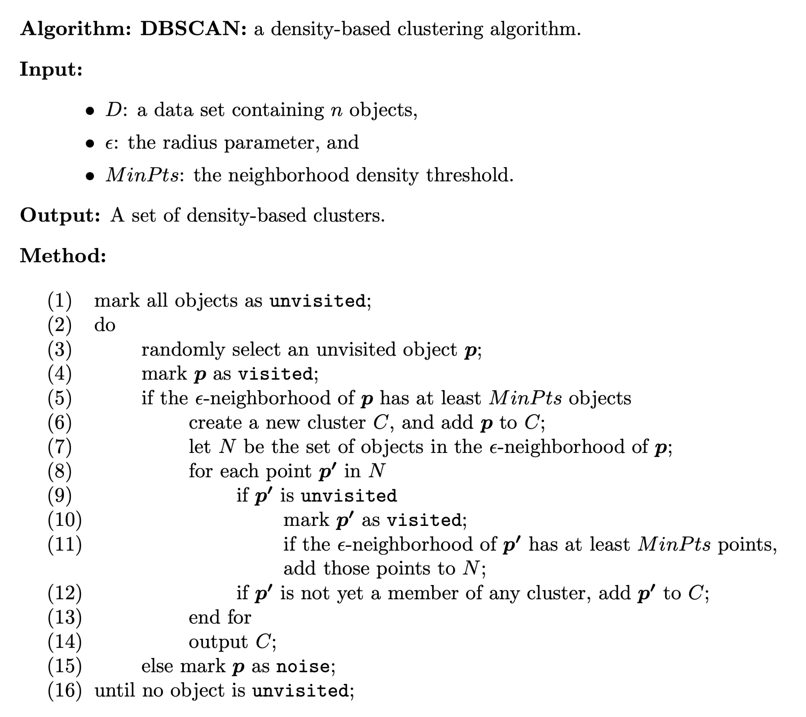

Slide 11
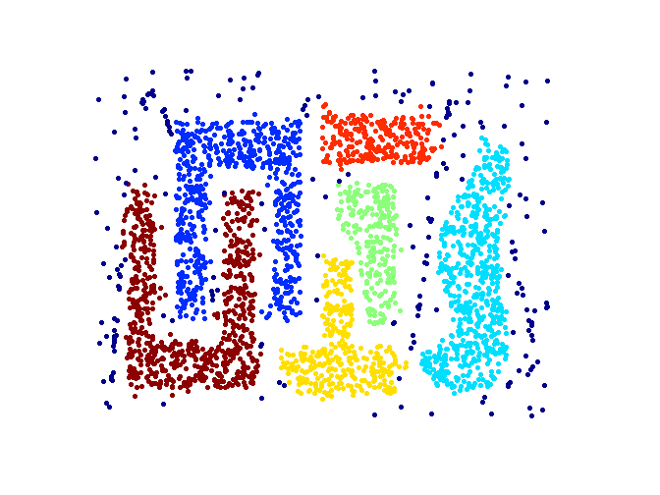
When DBSCAN Works Well
Original Points
Clusters
Resistant to Noise
Can handle clusters of different shapes and sizes

Slide 12
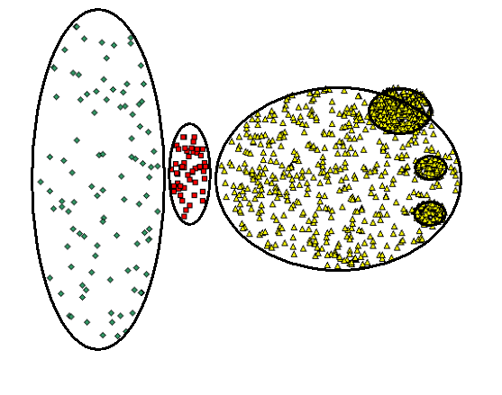
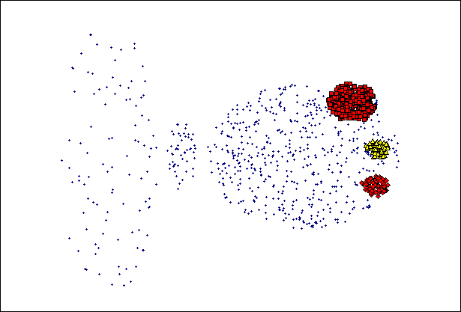
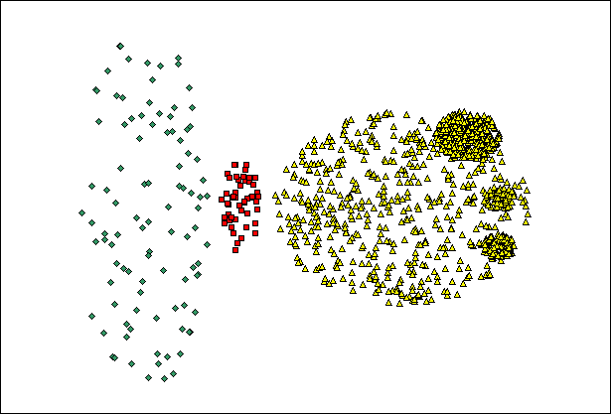
When DBSCAN Does NOT Work Well
(MinPts=4, Eps=9.75).
Original Points
Varying densities
High-dimensional data
(MinPts=4, Eps=9.92)

Slide 13
Time Complexity DBSCAN
Time Complexity: O(n²)
for each point, it has to be determined if it is a core point,
can be reduced to O(n*log(n)) in lower dimensional spaces by using efficient data structures (such as kd-trees)
kd-trees allow efficient retrieval of all points within a given distance of a specified point
(n is the number of objects to be clustered);

Slide 14
Space Complexity DBSCAN
Space Complexity: O(n)
Keep only a small amount of data for each point
The cluster label,
The identification of each point as a core, border, or noise point

Slide 15
Summary DBSCAN
Good:
can detect arbitrary shapes,
not very sensitive to noise,
supports outlier detection,
complexity is kind of okay, \
Bad
does not work well in high-dimensional datasets,
parameter selection is tricky,
has problems of identifying clusters of varying densities

Slide 16
Readings
Geron, Chapter 9
Clustering
/Reading/ in Canvas

